Slide 1

8th Grade Math: Pre-Algebra
Unit 7, Lesson 7 Interpreting Linear Relationships from Tables and Written Descriptions Volume 1, pg. 317

Slide 2


Benchmark
MA.8.AR.3.5
Given a real-world context, determine and interpret the slope and 𝑦-intercept of a two-variable linear equation from a written description, a table, a graph or an equation in slope-intercept form.
volume 1, pg. 317

Slide 3
Integrated Mathematical Thinking and Reasoning Standards
MA.K12.MTR.4.1 Engage in discussions that reflect on the mathematical thinking of self and others.
MA.K12.MTR.7.1 Apply mathematics to real-world contexts.
volume 1, pg. 317

Slide 4

Learning Targets
I can determine and interpret the slope and 𝑦-intercept of a two-variable linear equation from a table of values in a real-world context.
I can determine and interpret the slope and 𝑦-intercept of a two-variable linear equation from a written description in a real-world context.
volume 1, pg. 317

Slide 5

Warm-Up
volume 1, pg. 317

Slide 6
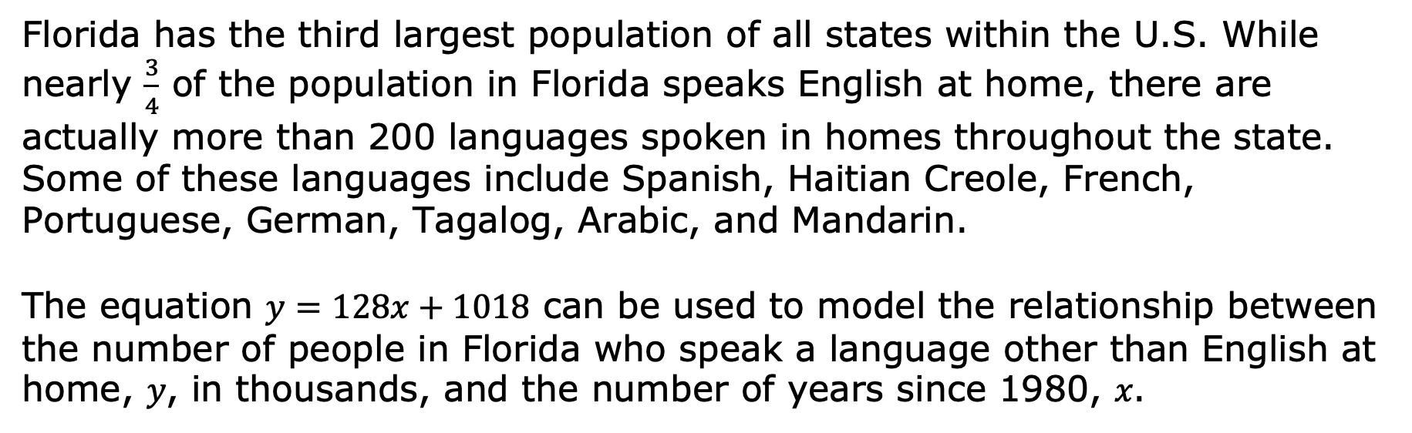
7.7.1 Warm-Up: Languages Spoken in Florida
Florida has the third largest population of all states within the U.S. While nearly $\frac{3}{4}$ of the population in Florida speaks English at home, there are actually more than 200 languages spoken in homes throughout the state. Some of these languages include Spanish, Haitian Creole, French, Portuguese, German, Tagalog, Arabic, and Mandarin.
The equation $y=128x+1018$ can be used to model the relationship between the number of people in Florida who speak a language other than English at home, 𝑦, in thousands, and the number of years since 1980, 𝑥.
volume 1, pg. 317

Slide 7
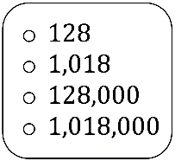
Complete the statement to interpret this relationship in context.
In 1980, approximately Floridians spoke a language other than English at home. Since then, the number of Floridians speaking a language other than English at home has grown by approximately people every year.
volume 1, pg. 317

Slide 8

Guided Instruction
volume 1, pg. 318

Slide 9

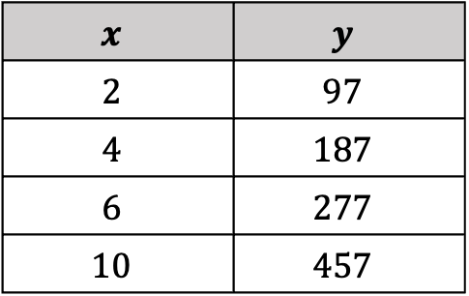
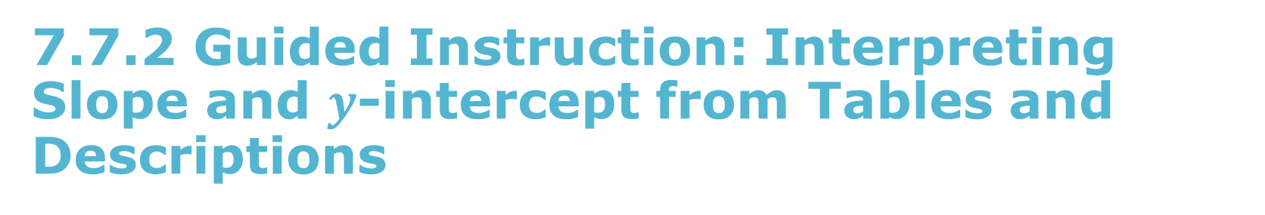
7.7.2 Guided Instruction: Interpreting Slope and $y$-intercept from Tables and Descriptions
Econ Rental Car is a company that rents cars using a linear pricing plan. The company charges a daily rate in addition to maintenance fees. The total cost in dollars, 𝑦, to rent a car for 𝑥 days is shown in the table.
$$x$$ | $$y$$
$$2$$ | $$97$$
$$4$$ | $$187$$
$$6$$ | $$277$$
$$10$$ | $$457$$
volume 1, pg. 318

Slide 10
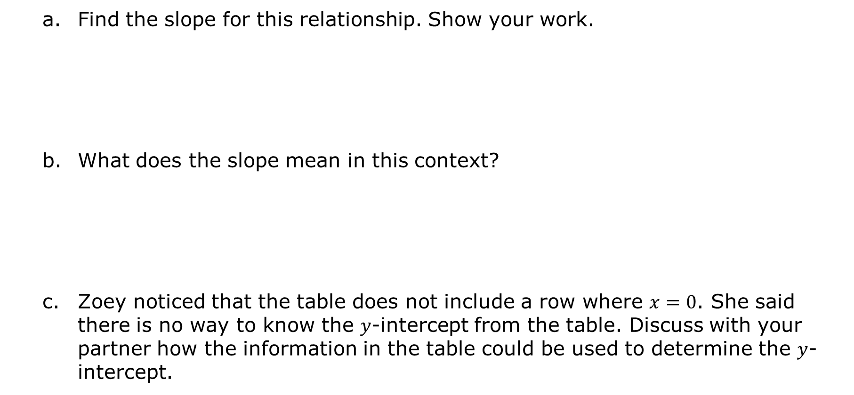
Find the slope for this relationship. Show your work.
What does the slope mean in this context?
Zoey noticed that the table does not include a row where $x=0$. She said there is no way to know the 𝑦-intercept from the table. Discuss with your partner how the information in the table could be used to determine the 𝑦-intercept.
volume 1, pg. 318

Slide 11
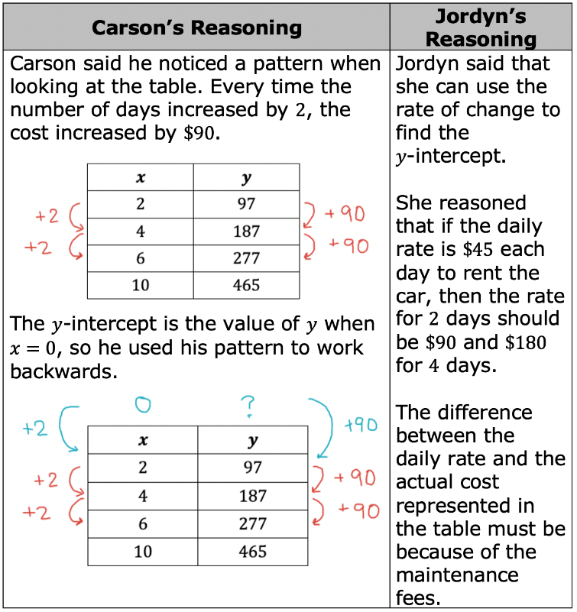
Carson and Jordyn determined the 𝑦-intercept using different reasoning. Their thinking is shared in the table below.
volume 1, pg. 318

Slide 12
Use either student’s reasoning to determine the 𝑦-intercept.
What does this 𝑦-intercept represent in the context?
volume 1, pg. 318

Slide 13
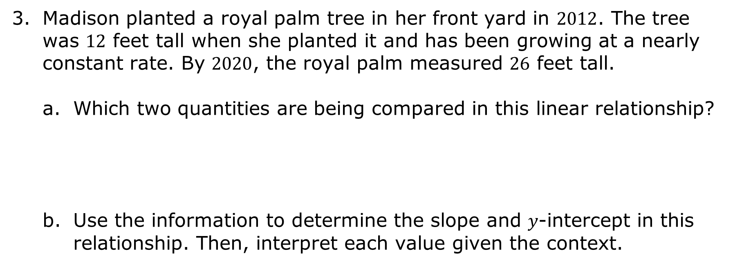
Madison planted a royal palm tree in her front yard in $2012$. The tree was $12$ feet tall when she planted it and has been growing at a nearly constant rate. By $2020$, the royal palm measured $26$ feet tall.
Which two quantities are being compared in this linear relationship?
Use the information to determine the slope and 𝑦-intercept in this relationship. Then, interpret each value given the context.
volume 1, pg. 319

Slide 14
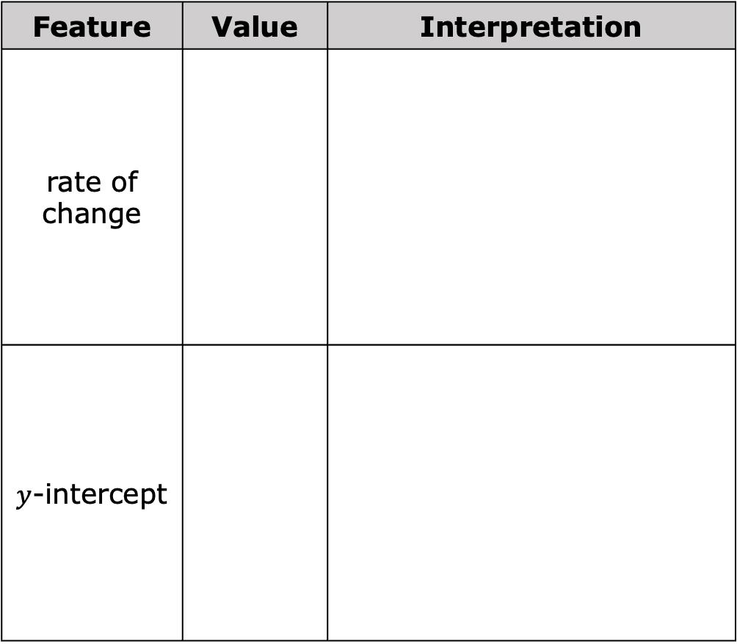
Feature | Value | Interpretation
rate of change
$y$-intercept
volume 1, pg. 319

Slide 15

Guided Practice
volume 1, pg. 319

Slide 16

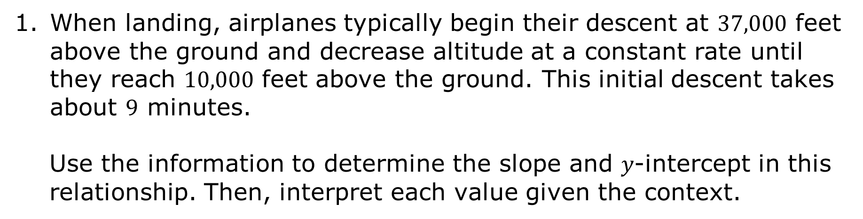
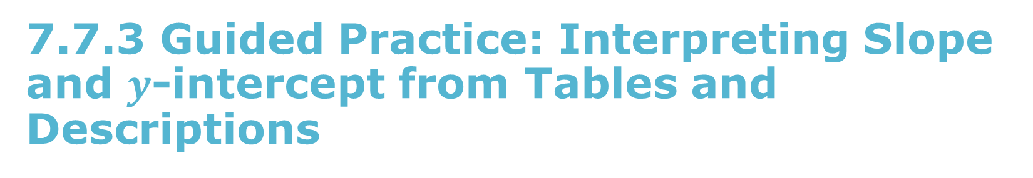
7.7.3 Guided Practice: Interpreting Slope and $y$-intercept from Tables and Descriptions
When landing, airplanes typically begin their descent at $37,000$ feet above the ground and decrease altitude at a constant rate until they reach $10,000$ feet above the ground. This initial descent takes about $9$ minutes.
Use the information to determine the slope and 𝑦‑intercept in this relationship. Then, interpret each value given the context.
volume 1, pg. 319

Slide 17

Feature | Value | Interpretation
slope
$y$-intercept
volume 1, pg. 319

Slide 18
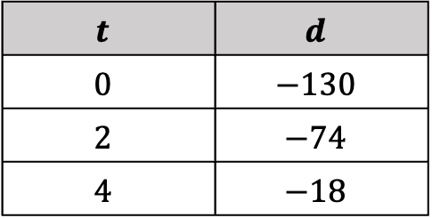
A scuba diver exploring a coral reef begins her ascent to the surface of the water. The table models the relationship between the depth of the diver, 𝑑, in feet and time in minutes, 𝑡, after she begins ascending to the surface.
$$t$$ | $$d$$
$$0$$ | $$−130$$
$$2$$ | $$−74$$
$$4$$ | $$−18$$
Use the information to determine the slope and 𝑦-intercept in this relationship. Then, interpret each value given the context.
volume 1, pg. 320

Slide 19

Feature | Value | Interpretation
slope
$y$-intercept
volume 1, pg. 320

Slide 20

Your Turn
volume 1, pg. 320

Slide 21

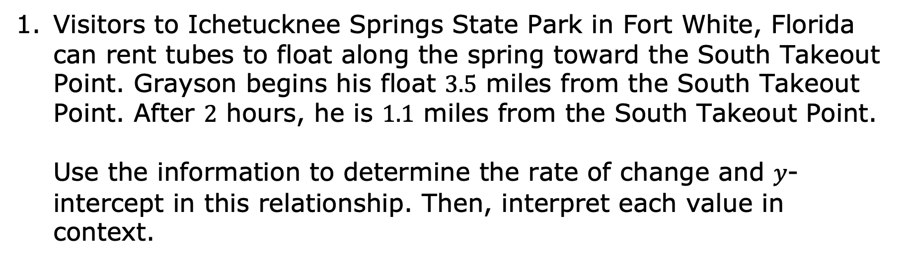
7.7.4 Your Turn!
Visitors to Ichetucknee Springs State Park in Fort White, Florida can rent tubes to float along the spring toward the South Takeout Point. Grayson begins his float $3.5$ miles from the South Takeout Point. After $2$ hours, he is $1.1$ miles from the South Takeout Point.
Use the information to determine the rate of change and 𝑦-intercept in this relationship. Then, interpret each value in context.
volume 1, pg. 320

Slide 22
Feature | Value | Interpretation
rate of change
$y$-intercept
volume 1, pg. 320

Slide 23
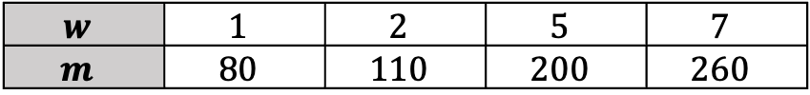
Elijah is saving money to buy a new PlayStation. He set some money he received for his birthday aside and then added more each week. The table shows the amount of money Elijah has saved at the end of each week, 𝑚, for the number of weeks he has been saving, 𝑤.
$$w$$ | $$1$$ | $$2$$ | $$5$$ | $$7$$
$$m$$ | $$80$$ | $$110$$ | $$200$$ | $$260$$
Use the information to determine the rate of change and 𝑦-intercept in this relationship. Then, interpret each value in context.
volume 1, pg. 321

Slide 24

Feature | Value | Interpretation
rate of change
$y$-intercept
volume 1, pg. 321

Slide 25

Wrap-Up
volume 1, pg. 321

Slide 26
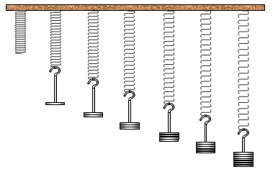
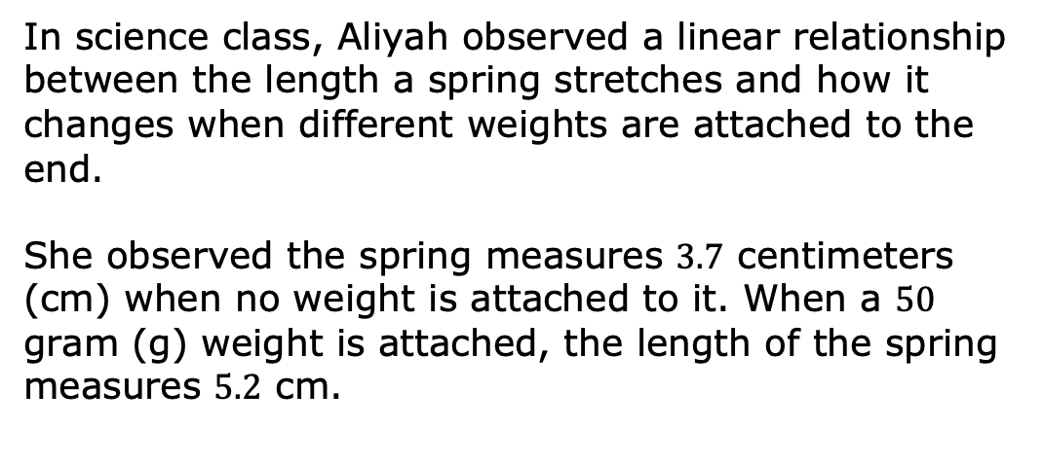
7.7.5 Wrap-Up: Ticket Out the Door
In science class, Aliyah observed a linear relationship between the length a spring stretches and how it changes when different weights are attached to the end.
She observed the spring measures $3.7$ centimeters (cm) when no weight is attached to it. When a $50$ gram (g) weight is attached, the length of the spring measures $5.2$ cm.
Use the information to determine the rate of change and 𝑦-intercept in this relationship. Then, interpret each value in context.
volume 1, pg. 321

Slide 27
Feature | Value | Interpretation
rate of change
$y$-intercept
volume 1, pg. 321

